Slide 1




Spelling
Plurals
This icon indicates that detailed teacher’s notes are available in the Notes Page.
This icon indicates the slide contains activities created in Flash. These activities are not editable.
For more detailed instructions, see the Getting Started presentation.
Notes:
This presentation matches objective W2.

Slide 2

Plurals
Adding ‘s’
To make plurals, often we just add ‘s’.
For example:
book
books
car
cars
sweet
sweets
Plurals like this are simple.
Can you think of any other ways to make plurals?

Slide 3
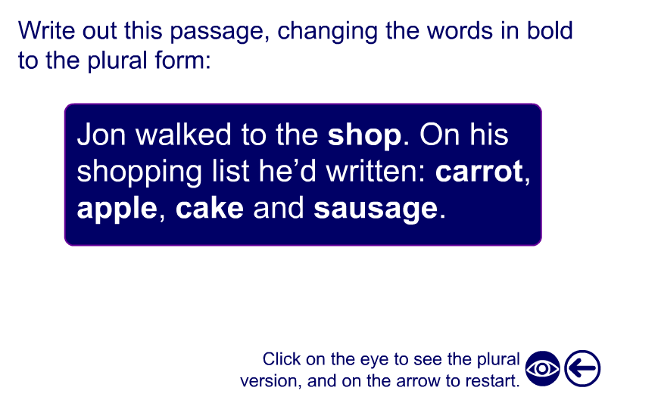
Activity

Slide 4
Adding -es
Words ending in -s, -x, -ch, -sh, -ss, -zz.
We add -es to words with these endings.
For example:
bus buses
church churches
NOTE:
There are some words which work differently.
stomach stomachs
quiz quizzes
Notes:
Students might find it helpful to know that if the word ends in a buzzing sound, then it becomes -es.

Slide 5
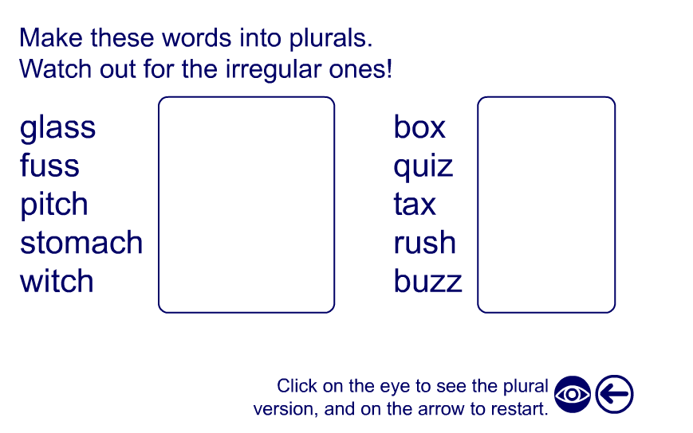
Activity

Slide 6
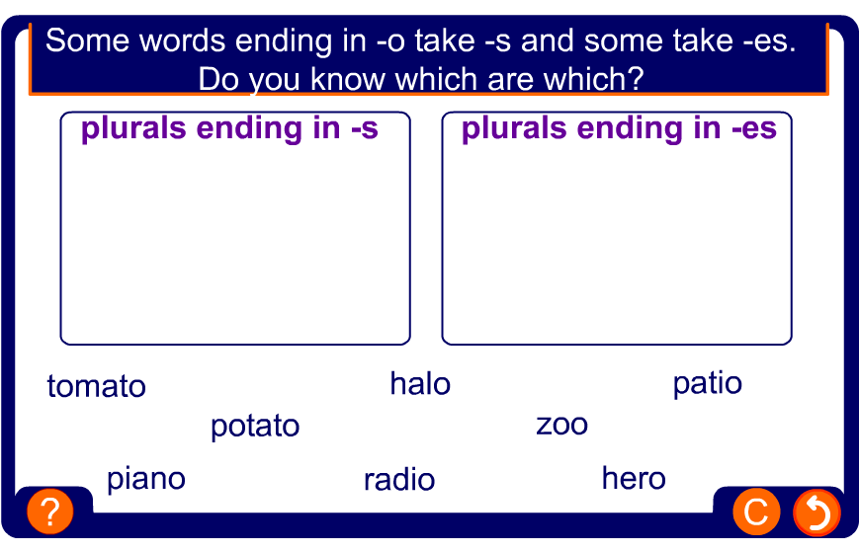
Activity
Notes:
After completing this exercise students could be asked to write down all correctly spelt plurals in their exercise books.

Slide 7
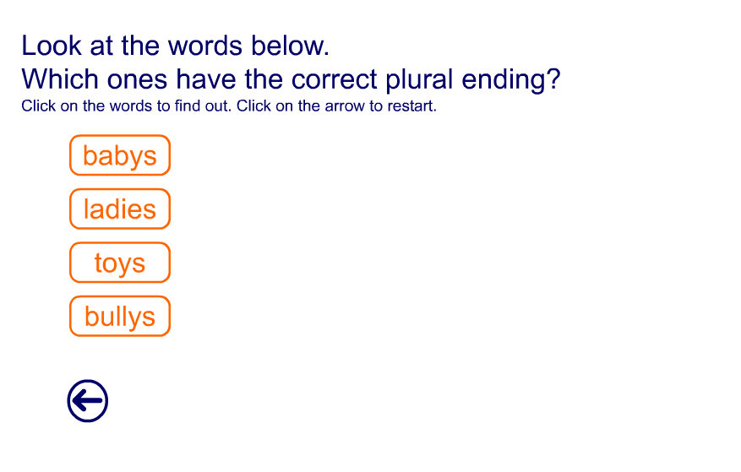
Activity

Slide 8
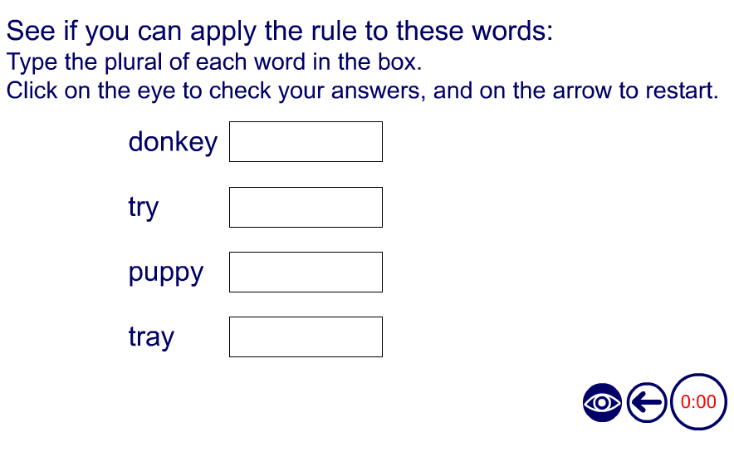
Activity

Slide 9
Words ending in -f and -fe
Some words ending in -f just take an s.
chief chiefs
roof roofs
belief beliefs
Words ending in -ff just add s.
cliff cliffs
sniff sniffs

Slide 10
Words ending in -f and -fe
Look what happens with these words:
half halves
calf calves
shelf shelves
knife knives
As you can see, many words form the plural by changing the f to v and adding es.
Some words use either way
E.g. hoof hoofs or hooves; dwarf dwarfs or dwarves

Slide 11
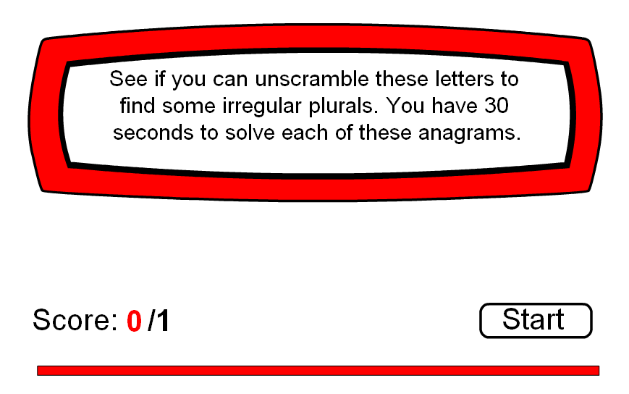
Activity

Slide 12
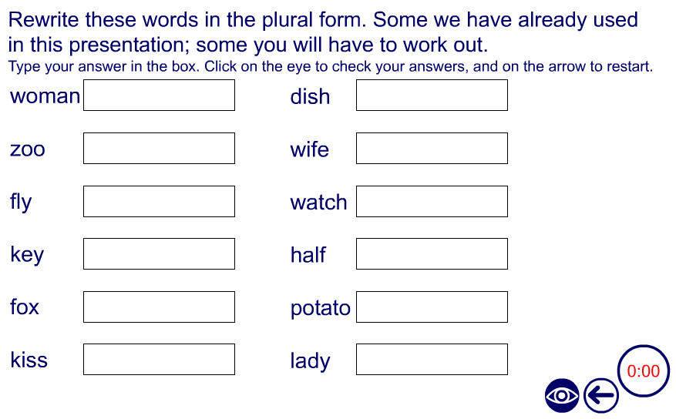
Activity

